Slide 1
THE EMORY MATH CIRCLE
BY GRIFFIN EDWARDS
What was the last thing you painted?

Slide 2

Paint This House
Goal: Paint the house with as few colors as possible.
No color is allowed to be next to itself.
What is the least number of colors can you use?

Slide 3

A New House
(Diagonal touching is okay)

Slide 4


Harder Pictures to Paint

Slide 5
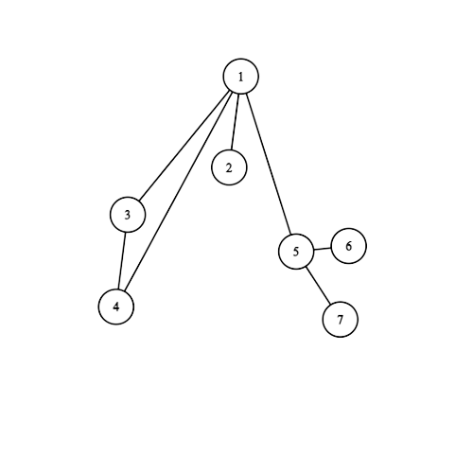
Turn Problem into Math
Pictures can become graphs!

Slide 6
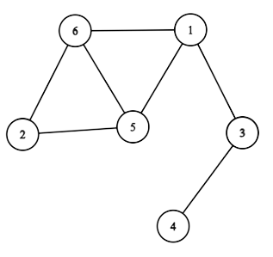
Graphs
Remember, a graph is a bunch of vertices (points) connected by edges. Here is another example
Fancy Vocab
The chromatic number of a graph is the smallest number of colors we can color the vertices so that no edge connects two vertices with the same color.

Slide 7
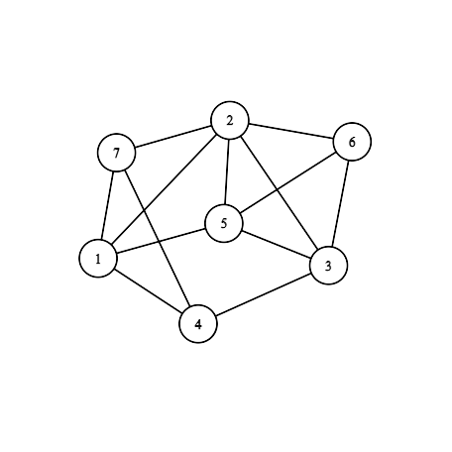
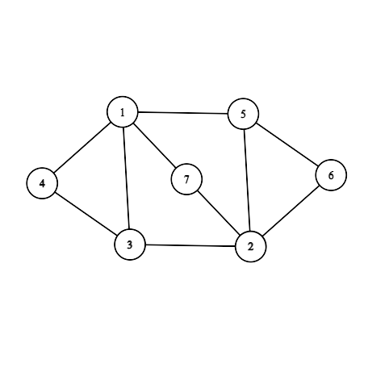
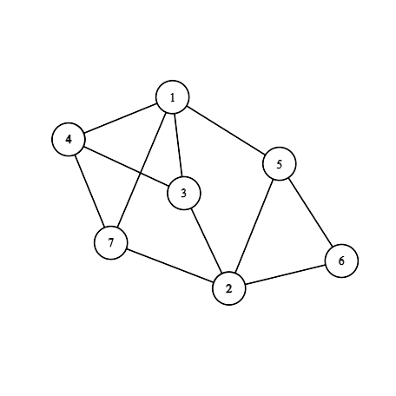
Find the Chromatic Number

Slide 8
BREAKOUT ROOMS!
Find the chromatic number of these graphs!

Slide 9
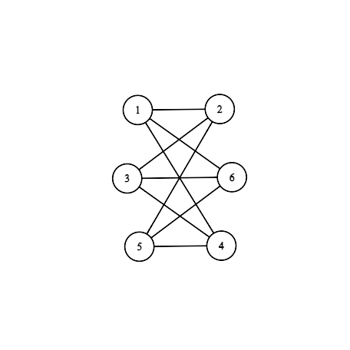
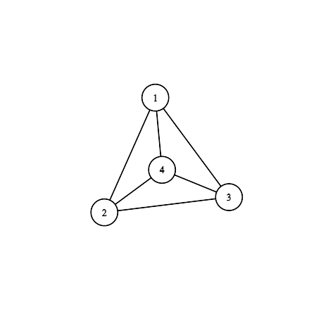
How Many Colors Do You Need?

Slide 10
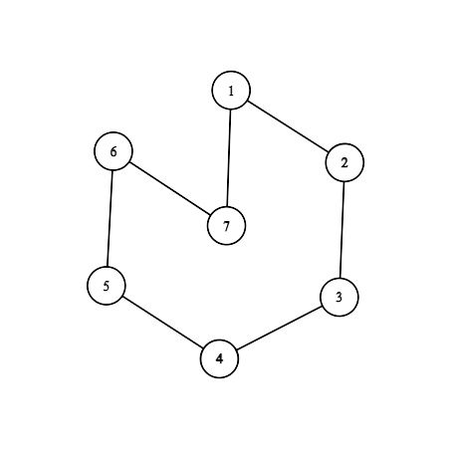
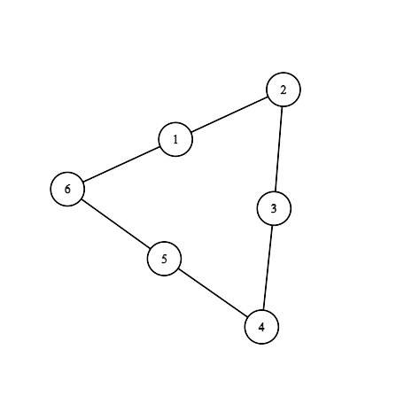
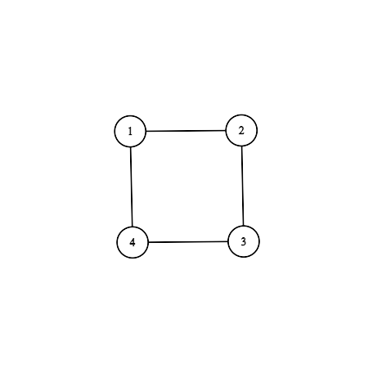
How Many Colors Do You Need?
These are called cycles! Odd cycles have an odd number of vertices, and even cycles have an even number of vertices.

Slide 11
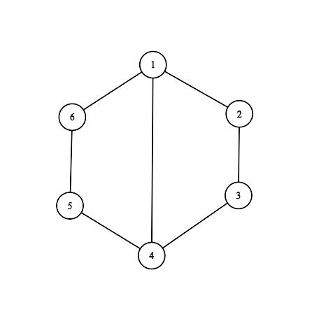
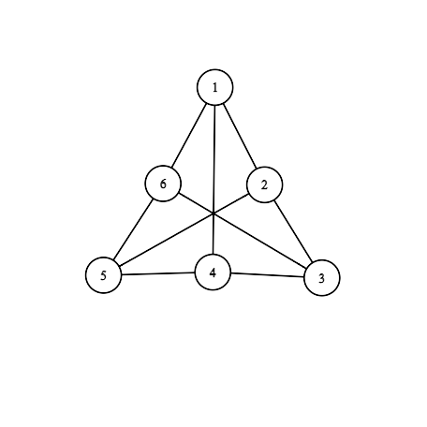
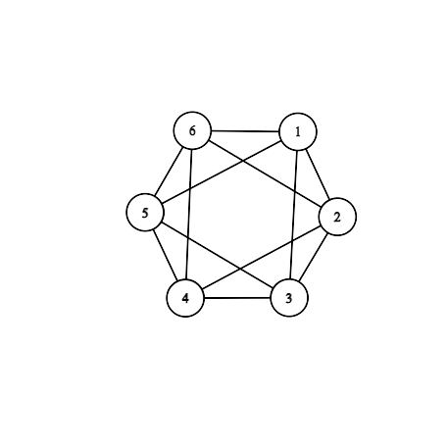
How about these Graphs?

Slide 12
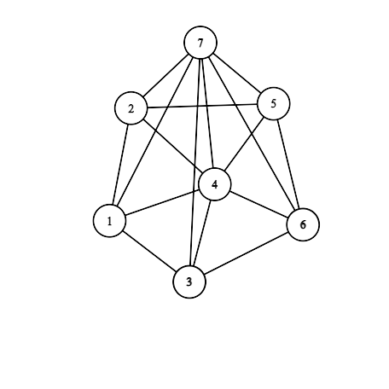
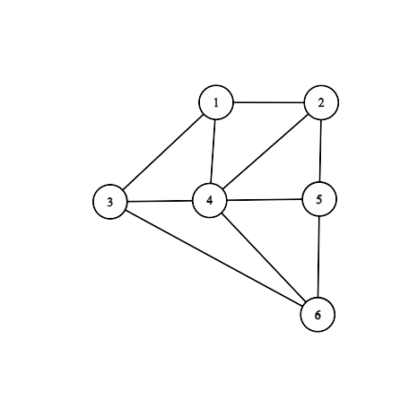
Cones
What effect is there if you add a vertex with an edge to every other vertex?

Slide 13
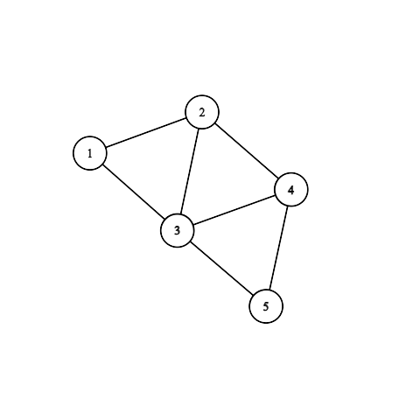
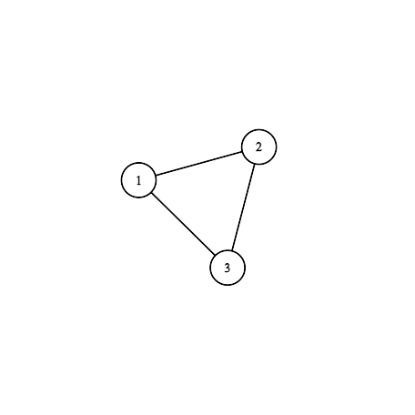
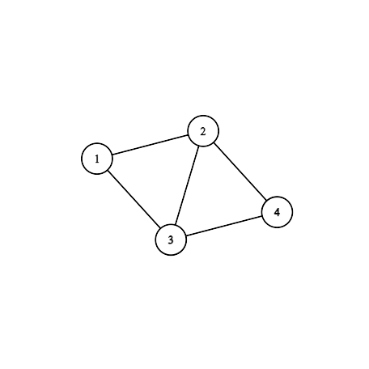
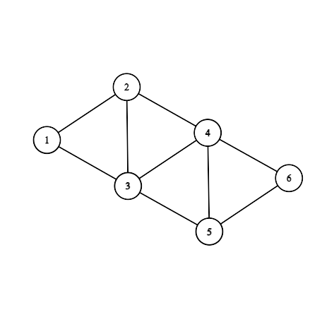
Learning When You Can Reduce

Slide 14
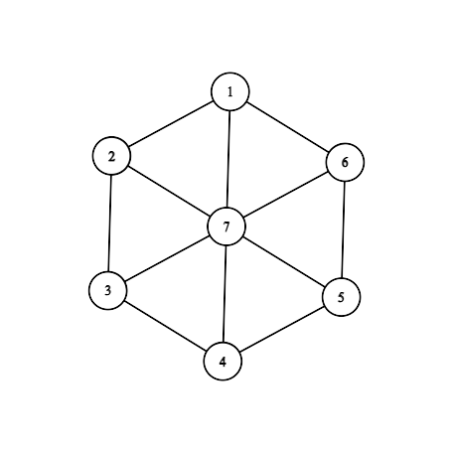
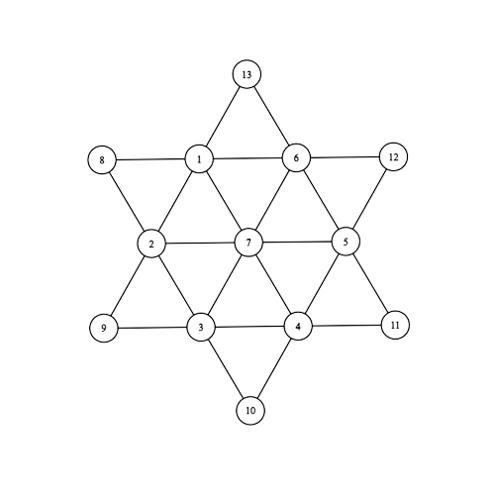
Apply Reduction Techniques

Slide 15
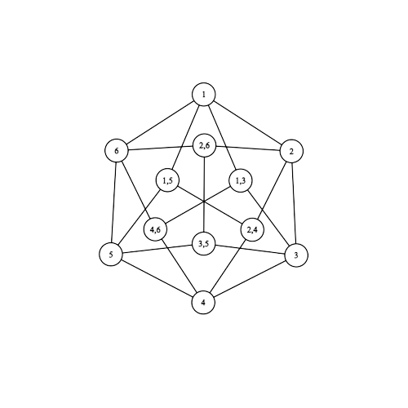
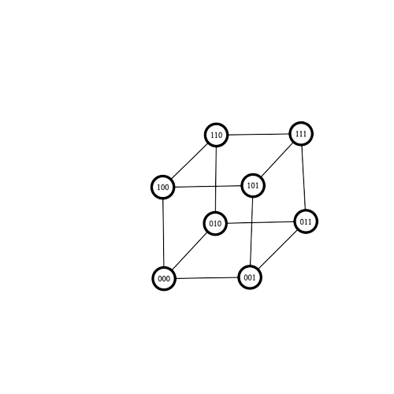
Not as bad as they look!
Hint: Think about even and odd!

Slide 16


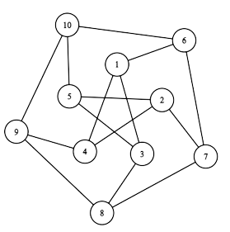
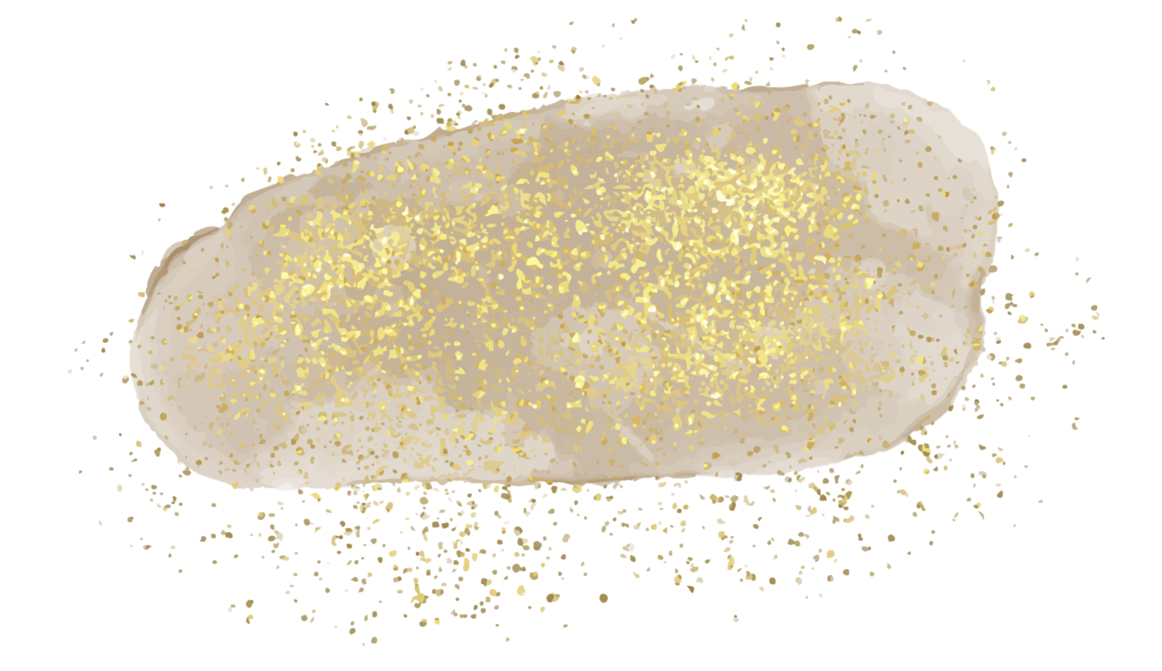


This one is hard!
Notes:
Need 4 colors

Slide 17
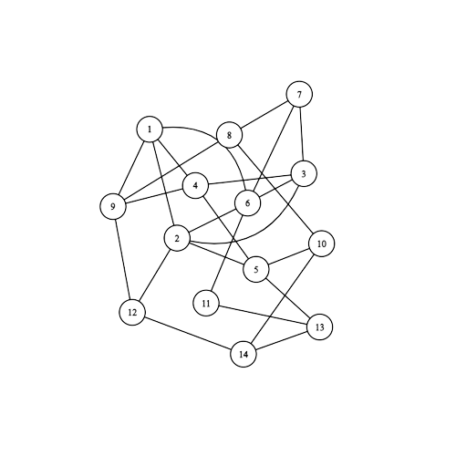
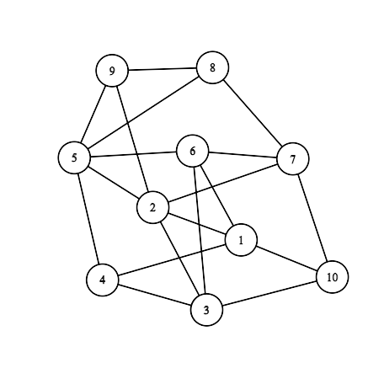
Challenges!
One is very tricky, the other has a secret quick way to solve it.
End of Breakout Rooms

Slide 18
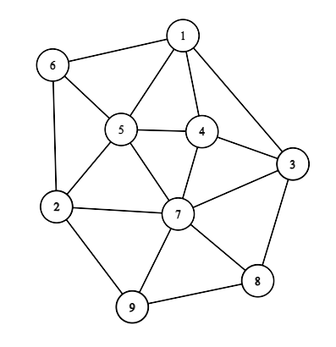
4 Color Theorem
Vocab: A graph is a plane graph if you can draw it on a piece of paper without the edges crossing. (You can zig-zag the lines.)
Any plane graph can be colored using four colors! (Try to draw examples at home!)

Slide 19
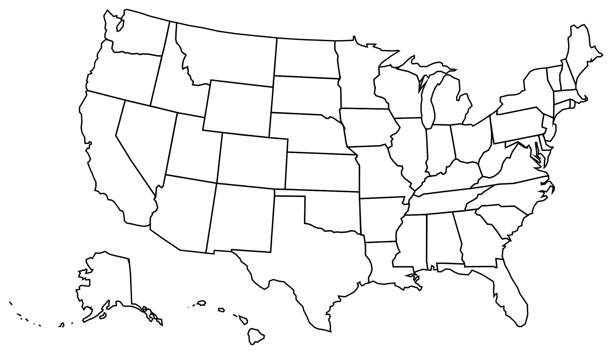
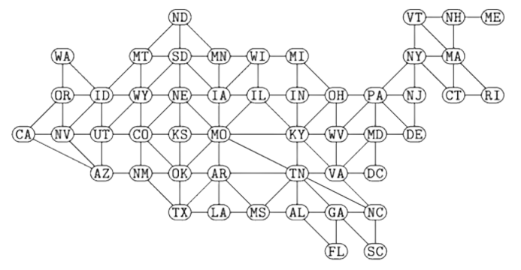
The United States as a Graph

Slide 20
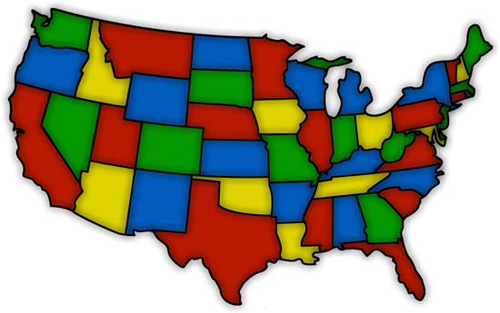

Slide 21
THANKS!
Do you have any questions?
grifffinedwards@gatech.edu
griffin-edwards.github.io
Please keep this slide for attribution

